Slide 1

American Sign Language Letters
Hand Sign Detection Model
Department of Information Technology
Jalpaiguri Government Engineering College
Notes:
Entered text
Abstract
This project report presents the development and implementation of an ASL
hand detection model using computer vision and deep learning techniques.
The goal of this project is to enable real-time and accurate detection of
American Sign Language (ASL) hand gestures, thereby bridging the
communication gap between individuals with hearing impairments and the
general population.
The report begins by providing an overview of the ASL hand detection model's
significance in facilitating communication for the hearing-impaired
community. It highlights the importance of accurate hand detection for
interpreting sign language gestures and translating them into corresponding
textual or vocal outputs.
Next, the report delves into the methodology employed for developing the
ASL hand detection model. It discusses the use of convolutional neural
networks (CNNs) and the YOLO (You Only Look Once) algorithm for object
detection. The Ultralytics repository and its modules are utilized to implement
the model, taking advantage of their comprehensive functionalities for
efficient training and inference.
Furthermore, the report outlines the dataset used for training the ASL hand
detection model. The dataset, obtained from Roboflow, consists of diverse
ASL hand gesture images, enabling the model to learn and generalize hand
features effectively.
The evaluation of the ASL hand detection model is then presented, including
metrics such as precision, recall, and mean average precision (mAP). The
model's performance is assessed on various test datasets, demonstrating its
ability to accurately detect ASL hand gestures in real-world scenarios.
Entered text
American Hand Sign Language Translation using Computer Vision is a technology that aims to recognize and translate hand signs into spoken or written language without relying on neural networks. This technology uses computer vision techniques to detect and track hand movements in real-time video streams, and then applies image processing algorithms to recognize the hand signs. This approach typically involves detecting the hand region, segmenting the hand from the background, and extracting relevant features, such as hand shape and orientation. These features are then matched with a pre-defined dictionary of hand signs to recognize the sign and translate it into spoken or written language.
Entered text
Literature Review
Significance of ASL Hand Detection
Accurate ASL hand detection plays a significant role in facilitating communication for
individuals with hearing impairments. The literature highlights the challenges faced by the
hearing-impaired community in expressing themselves and understanding others who do
not know sign language.
The literature review explores previous research and approaches in the field of ASL hand
detection. It examines academic papers, articles, and existing models that have been
developed for hand gesture recognition in sign language. Different techniques and
methodologies used in ASL hand detection are discussed, ranging from traditional rulebased methods to more advanced approaches leveraging deep learning.
Various research studies have explored template matching techniques, where hand
gestures are matched against predefined templates. Rule-based methods utilize specific
rules and heuristics to recognize hand shapes and movements. More recent approaches
have focused on deep learning-based methods, particularly convolutional neural networks
(CNNs) and recurrent neural networks (RNNs). Hybrid models combining different
techniques have also been proposed to improve accuracy and robustness.
The literature review provides insights into the strengths and limitations of these
approaches, shedding light on their performance, computational requirements, and
scalability. It also identifies gaps and challenges in the existing literature, highlighting the
need for further research and innovation in the field of ASL hand detection.
Related Technologies and Tools
This subsection explores related technologies and tools that support ASL hand detection.
Computer vision techniques form a crucial part of ASL hand detection systems, involving
image preprocessing, feature extraction, and object detection algorithms. The literature
review examines different computer vision techniques employed in ASL hand detection
research, such as edge detection, contour analysis, and motion tracking.
Deep learning frameworks and architectures commonly utilized in ASL hand detection are
discussed, including CNNs, RNNs, and their variants (e.g., LSTM, GRU). The literature
highlights the advantages of deep learning in capturing complex spatial and temporal
features of hand gestures. It also mentions specific tools, libraries, and repositories that
have been used in ASL hand detection projects, such as OpenCV, TensorFlow, PyTorch, and
Ultralytics.

Slide 2
Prepared by :
Abhishek Srivastav
Akash kumar shaw
Shouvik De
Shreetama Mukherjee
Under the supervision
of :
Prof. Subrata Kumar Mandal
Department of Information Technology

Slide 3
Content
Abstract
Problem Statement
Objective
Scope and Significance
Methodology of Proposed Algorithms
Proposed Work
Results
Conclusion & Future Work

Slide 4
Introduction :
Development and Implementation of an ASL Hand Detection Model using Computer Vision and Deep Learning Techniques
This project presents the development and implementation of an ASL hand detection model using computer vision and deep learning techniques. The goal of this project is to enable real-time and accurate detection of American Sign Language (ASL) hand gestures, thereby bridging the communication gap between individuals with hearing impairments and the general population.
Individuals with hearing impairments often face communication challenges in their daily lives. Spoken languages may be inaccessible to them, making it difficult to interact with others who do not understand sign language. Sign language, particularly ASL, plays a crucial role in bridging this communication gap by providing a means for individuals with hearing impairments to express themselves and understand others.

Slide 5
Problem Statement
The problem addressed in this project is the communication barrier faced by the deaf and hard-of-hearing community due to the lack of understanding of sign language by the general public.
Sign language is an essential tool for communication for these individuals, and the inability of others to comprehend it can lead to social exclusion and communication barriers in various aspects of life, such as education, employment, and social interactions.

Slide 6
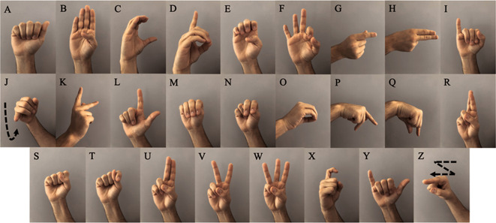
Objective
efficient feature extraction methods for recognizing hand signs, such as using shape analysis, texture analysis, or motion analysis.
Sign dictionary: Developing a comprehensive sign dictionary that includes a wider range of hand signs, including more complex signs and phrases.
Real-time tracking: Developing more advanced real-time tracking methods that can track hand movements in 3D space, which could help to improve the recognition accuracy and robustness of the system.
User interface: Developing a more user-friendly and accessible interface for the system, such as a mobile application or a web-based platform.
Multilingual support: Expanding the system to recognize and translate other sign languages used around the world, which could improve communication access for the global deaf and hard-of-hearing community.

Slide 7
Scope
Hand Shape Detection: The project will involve developing algorithms to accurately detect and classify different hand shapes used in ASL.
Finger Movement Detection: The project will also address the detection and tracking of finger movements, as they play a crucial role in sign language expression. The model will aim to capture and interpret various finger motions and gestures accurately.
Real-Time Performance: The developed ASL hand detection model will be designed to operate in real-time, providing immediate feedback and recognition of hand gestures. Real-time performance is crucial for enabling fluid communication between individuals with hearing impairments and others.

Slide 8
Significance of ASL Hand Detection
The literature review explores previous research and approaches in the field of ASL hand detection.
Accurate ASL hand detection facilitates communication for individuals with hearing impairments.
Hearing-impaired individuals face challenges in expressing themselves and understanding others who do not know sign language.
It examines academic papers, articles, and existing models that have been developed for hand gesture recognition in sign language.
Different techniques and methodologies used in ASL hand detection are discussed, ranging from traditional rule-based methods to more advanced approaches leveraging deep learning.

Slide 9
Evaluation of ASL Hand Detection Model
Demonstrates ability to accurately detect ASL hand gestures in real-world scenarios
Metrics such as precision, recall, and mean average precision (mAP) used for evaluation
Assessed on various test datasets

Slide 10
Methodology for Developing ASL Hand Detection Model
Use of convolutional neural networks (CNNs)
YOLO v8 algorithm for object detection
Utilization of Ultralytics repository and modules for efficient training and inference

Slide 11
Related Technologies and Tools
Computer vision techniques form a crucial part of ASL hand detection systems.
Deep learning frameworks and architectures commonly utilized in ASL hand detection are discussed, including CNNs, RNNs, and their variants (e.g., LSTM, GRU).
The literature review examines different computer vision techniques employed in ASL hand detection research, such as edge detection, contour analysis, and motion tracking.
Specific tools, libraries, and repositories that have been used in ASL hand detection projects, such as OpenCV, TensorFlow, PyTorch, and Ultralytics are mentioned.

Slide 12
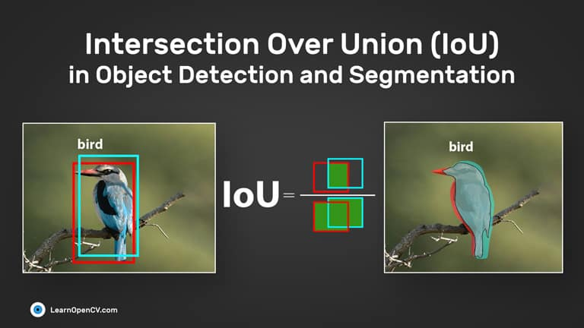
Yolo(You only look once) :
Residual blocks: First, the image is divided into different grids. Each grid has dimension S x S. The process of converting the input image to grids is shown in the following figure. Each grid cell will detect objects that appear in it.
Bounding box regression: A bounding box is an outline that highlights an object in an image with some attributes such as width, height and class , which is represented by the letter C. The center of the bounding box . YOLO uses single bounding box regression to predict objects' height, width, center, and class.
Intersection over Union (IOU): Intersection over Union (IOU) is a tool in object detection that explains how boxes overlap. YOLO uses IOUs to surround perfect output boxes for objects perfectly. Each cell in the grid is responsible for predicting bounding boxes and their confidence scores. If the predicted bounding box is the same as the actual box, then the IOU equals 1. This technique can eliminate bounding boxes that do not equal the actual box.

Slide 13
Implementation
Data Acquisition and Pre-processing
Setting Up the Development Environment
Training the ASL Hand Detection Model
Evaluation Metrics and Performance Analysis

Slide 14
Result
An analysis of individual classes reveals variations in the model's performance. Classes such as B, C, E, F, G, H, L, O, Q, S, W, X, and Z achieved high precision and recall values, indicating successful detection and classification of corresponding hand gestures. These classes consistently attained mAP50 and mAP50-95 scores of above 0.95, suggesting a high level of accuracy in recognizing these gestures.
However, certain classes such as I, J, K, N, P, R, T, U, V, and Y exhibited lower precision and recall values, indicating room for improvement in detecting and classifying their respective hand gestures. The model achieved relatively lower mAP scores for these classes, highlighting the challenges faced in accurately identifying these gestures.

Slide 15
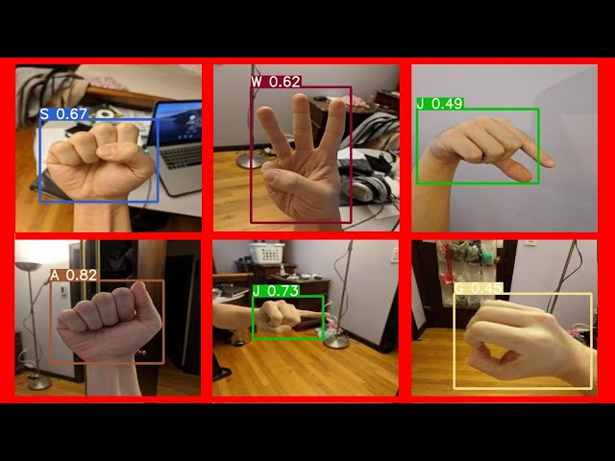

Slide 16
Future Scope
Another area of future enhancement lies in providing real-time feedback and gesture correction capabilities within the ASL hand detection model
One of the key applications of the ASL hand detection model is its integration with sign language interpretation systems.
Wearable devices or smart glasses equipped with the model can provide real-time feedback and assistance, guiding users in their interactions with others
By deploying the model on mobile devices, individuals with hearing impairments can have access to on-the-go communication assistance.

Slide 17
Limitations
Focus on Hand Gestures: The project primarily focuses on hand gestures and their recognition within ASL. It may not include the interpretation of facial expressions, body movements, or other non-manual components of sign language.
Hardware Resources: The project considers hardware resources and limitations, ensuring that the developed ASL hand detection model can run efficiently on different devices.
Dataset and Training: The projectl utilizes the Roboflow dataset and the Ultralytics platform. The training and evaluation of the ASL hand detection model is be based on these resources, and other datasets may not be explored within the scope of this project.

Slide 18
Conclusion
The ASL hand detection model demonstrated high accuracy and performance in detecting ASL hand gestures.
The development and implementation of the ASL hand detection model contribute significantly to the fields of computer vision and assistive technologies. The model's ability to accurately detect ASL hand gestures bridges the communication gap for individuals with hearing impairments.
While the ASL hand detection project has achieved notable success, there are several avenues for future research and development in the field. Further enhancements to the model can focus on improving accuracy, extending gesture recognition capabilities to include more complex gestures, and exploring multi-modal approaches that integrate hand movements with facial expressions.

Slide 19
Thank You.

